Slide 1

Deadlocks

Slide 2
Syllabus
Deadlock:
Principles of Deadlock, Deadlock Modeling, Deadlock Prevention, Deadlock Avoidance, Deadlock detection and recovery.
COMPUTER ENGINEERING AND TECHNOLOGY

Slide 3

References
1. Abraham Silberschatz, Peter Baer Galvin and Greg Gagne, Operating System Concepts, WILEY,ISBN 978-1-118-06333-0, 9th Edition
21/02/19
Operating system
Notes:
MIT-WPU

Slide 4
Deadlocks
Finite number of resources to be distributed among a number of competing processes
A set of blocked processes each holding a resource and waiting to acquire a resource held by another process in the set.

Slide 5
The Deadlock Problem
Example
  System has 2 tape drives.
  P₁ and P₂ each hold one tape drive and each needs another one.

Slide 6
Bridge Crossing Example
Traffic only in one direction.
Each section of a bridge can be viewed as a resource.
If a deadlock occurs, it can be resolved if one car backs up (preempt resources and rollback).
Several cars may have to be backed up if a deadlock occurs.
Starvation is possible.

Slide 7
System Model
Resource types R₁, R₂, . . ., R_{m}
    CPU , memory space, I/O devices
Each resource type R_{i} has W_{i} instances.
Each process utilizes a resource as follows:
  request
  use
  release

Slide 8
Deadlock Characterization
Deadlock can arise iff four conditions hold simultaneously.
Mutual exclusion: resource must be held in a nonshareable mode
Hold and wait: a process holding at least one resource is waiting to acquire additional resources held by other processes.
No preemption: a resource can be released only voluntarily by the process holding it, after that process has completed its task.
Circular wait: there exists a set {P₀, P₁, …, P_{n}} of waiting processes such that P₀ is waiting for a resource that is held by P₁, P₁ is waiting for a resource that is held by P₂, …, P_{n–1} is waiting for a resource that is held by P_{n}, and P_{n} is waiting for a resource that is held by P₀.

Slide 9
Resource-Allocation Graph
A set of vertices V and a set of edges E.
V is partitioned into two types:
  P = {P₁, P₂, …, P_{n}}, the set consisting of all the processes in the system.
  R = {R₁, R₂, …, R_{m}}, the set consisting of all resource types in the system.
request edge – directed edge P_{i} → R_{j}
assignment edge – directed edge R_{j} → P_{i}

Slide 10
Resource-Allocation Graph (Cont.)
Process
Resource Type with 4 instances
P_{i} requests instance of R_{j}
P_{i} is holding an instance of R_{j}
P_{i}
R_{j}
P_{i}
R_{j}

Slide 11

Example of a Resource Allocation Graph

Slide 12

Resource Allocation Graph With A Deadlock

Slide 13

Resource Allocation Graph With A Cycle But No Deadlock

Slide 14
Basic Facts
If graph contains no cycles ⇒ no deadlock.
If graph contains a cycle ⇒
  if only one instance per resource type, then deadlock.
  if several instances per resource type, possibility of deadlock.

Slide 15
Methods for Handling Deadlocks
Ensure that the system will never enter a deadlock state.
Allow the system to enter a deadlock state and then recover
Ignore

Slide 16
Deadlock Prevention
By ensuring that atleast one of the conditions cannot hold, we can prevent deadlock
1. Mutual Exclusion – some resources are inherently nonsharable eg. printer.
2. Hold and Wait –
  Require process to request and be allocated all its resources before it begins execution
  Low resource utilization; starvation possible.

Slide 17
Deadlock Prevention (Cont.)
3. No Preemption –
  If a process that is holding some resources & requests another resource that cannot be immediately allocated to it, then all resources currently being held are released.
  Preempted resources are added to the list of resources for which the process is waiting.
  Process will be restarted only when it can regain its old resources, as well as the new ones that it is requesting.
4. Circular Wait – impose a total ordering of all resource types, and require that each process requests resources in an increasing order of enumeration.

Slide 18
Deadlock Prevention (Cont.)
Circular Wait – impose a total ordering of all resource types, and require that each process requests resources in an increasing order of enumeration (eg. Disk needed before printer, so Number assigned to printer > Number assigned to disk)
R = {R₁, R₂, …, R_{m}} the set consisting of all resource types in the system
Assign a unique integer number to each resource type
A process can initially request any number of instances of a resource type R_{i}
After that process can request instances of a resource type R_{j} iff
Number of R_{j} > Number of R_{i}
If several instances of some resource type are needed, a single request for all must be issued

Slide 19
Deadlock Prevention (Cont.)
Notes:
MIT-WPU

Slide 20
Deadlock Avoidance
Requires that the system has some additional a priori information available.
Simplest and most useful model requires that each process declare the maximum number of resources of each type that it may need.
Uses concept of safe state

Slide 21
Safe State
System is in safe state if there exists a safe sequence of all processes.
Sequence <P₁, P₂, …, P_{n}> is safe if for each P_{i}, the resources that P_{i} can still request can be satisfied by currently available resources + resources held by all the P_{j}, with j<i.
  If P_{i} resource needs are not immediately available, then P_{i} can wait until all P_{j} have finished.
  When P_{j} is finished, P_{i} can obtain needed resources, execute, return allocated resources, and terminate.
  When P_{i} terminates, P_{i+1} can obtain its needed resources, and so on.

Slide 22
Safe State
If no such sequence exists, then system is in unsafe state
If a system is in safe state ⇒ no deadlocks.
If a system is in unsafe state ⇒ possibility of deadlock.

Slide 23

Safe, unsafe , deadlock state spaces

Slide 24
Data Structures for the Banker’s Algorithm
Let n = number of processes, and m = number of resources types.
Available: Vector of length m. If available [j] = k, there are k instances of resource type R_{j} available.
Max: n x m matrix. If Max [i,j] = k, then process P_{i} may request at most k instances of resource type R_{j}.
Allocation: n x m matrix. If Allocation[i,j] = k then P_{i} is currently allocated k instances of R_{j.}
Need: n x m matrix. If Need[i,j] = k, then P_{i} may need k more instances of R_{j} to complete its task.
    Need [i,j] = Max[i,j] – Allocation [i,j].

Slide 25
Banker’s Algorithm
Request_{i} = request vector for process P_{i}. If Request_{i} [j] = k then process P_{i} wants k instances of resource type R_{j.}
  1. If Request_{i} ≤ Need_{i} go to step 2. Otherwise, raise error condition, since process has exceeded its maximum claim.
  2. If Request_{i} ≤ Available, go to step 3. Otherwise P_{i} must wait, since resources are not available.
  3. Pretend to allocate requested resources to P_{i} by modifying the state as follows:
      Available := Available - Request_{i};
      Allocation_{i} := Allocation_{i} + Request_{i};
      Need_{i} := Need_{i} – Request_{i;;}
    Call safety algorithm
    If safe ⇒ the resources are allocated to P_{i}.
    If unsafe ⇒ P_{i} must wait, and the old resource-allocation state is restored

Slide 26
Safety Algorithm
To determine whether system is in safe state
1. Let Work and Finish be vectors of length m and n, respectively. Initialize:
      Work := Available
      Finish [i] = false for i = 1,2, …, n.
2. Find an i such that both:
  (a) Finish [i] = false
  (b) Need_{i} ≤ Work
  If no such i exists, go to step 4.
3. Work := Work + Allocation_{i}
Finish[i] := true
go to step 2.
4. If Finish [i] = true for all i, then the system is in a safe state.

Slide 27
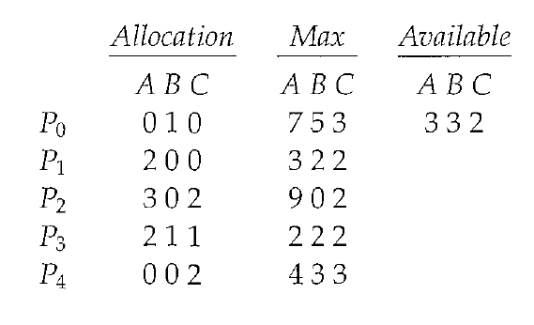
Example of Banker’s Algorithm
5 processes P₀ through P₄; 3 resource types A (10 instances), B (5 instances), and C (7 instances).
Snapshot at time T₀:

Slide 28
Example (Cont.)
The content of the matrix. Need is defined to be Max – Allocation.
Need
A B C
P₀ 7 4 3
P₁ 1 2 2
P₂ 6 0 0
P₃ 0 1 1
P₄ 4 3 1
The system is in a safe state since the sequence < P₁, P₃, P₄, P₀, P₂> or < P₁, P₃, P₄, P₂, P₀> satisfies safety criteria.

Slide 29
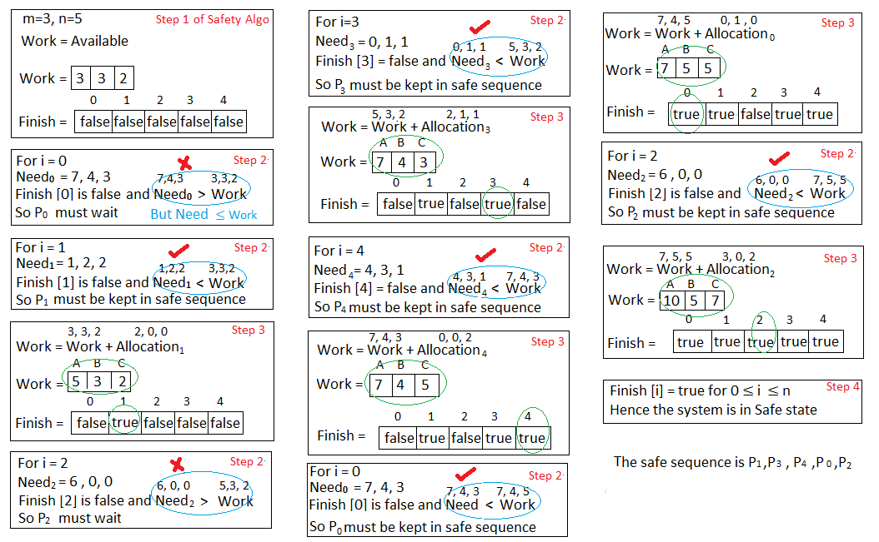


Slide 30
Example (Cont.)……
At time T₁:
P₁ request (1,0,2)

Slide 31
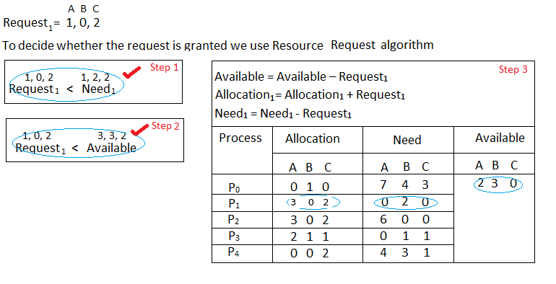

Slide 32
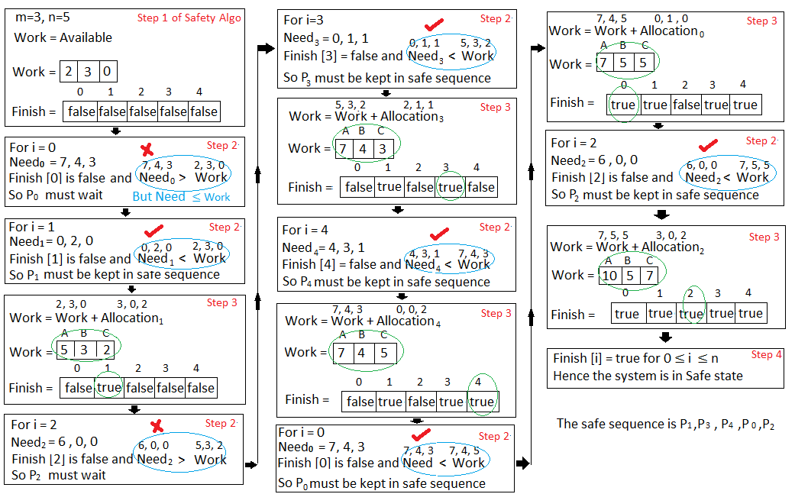

Slide 33
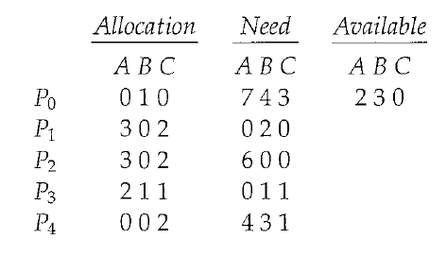
Example (Cont.): P₁ request (1,0,2)
Check that Request ≤ Available (that is, (1,0,2) ≤ (3,3,2) ⇒ true.
Executing safety algorithm shows that sequence <P₁, P₃, P₄, P₀, P₂> satisfies safety requirement.

Slide 34
Example (Cont.)
At time T₂: Can request for (3,3,0) by P₄ be granted?
At time T₃: Can request for (0,2,0) by P₀ be granted?

Slide 35
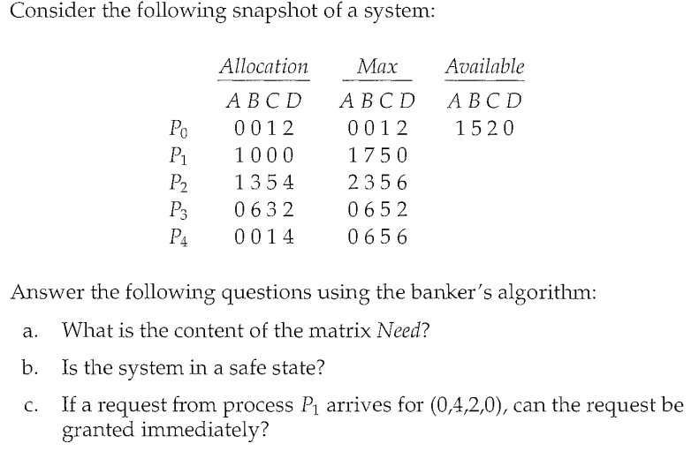
2. Example of Banker’s Algorithm

Slide 36
Recovery from Deadlock: Process Termination
Abort all deadlocked processes.
Abort one process at a time until the deadlock cycle is eliminated.
In which order should we choose to abort?
  Priority of the process.
  How long process has computed, and how much longer to completion.
  Resources the process has used.
  Resources process needs to complete.
  How many processes will need to be terminated.
  etc…

Slide 37
Recovery from Deadlock: Resource Preemption
Selecting a victim
Rollback
Starvation – same process may always be picked as victim, include number of rollbacks

